Slide 1
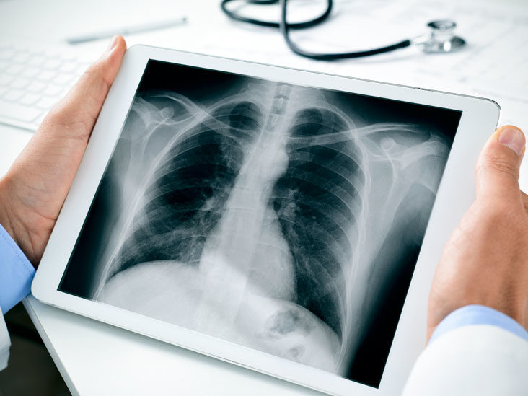

XRay Image Classification for COVID-19

Slide 2
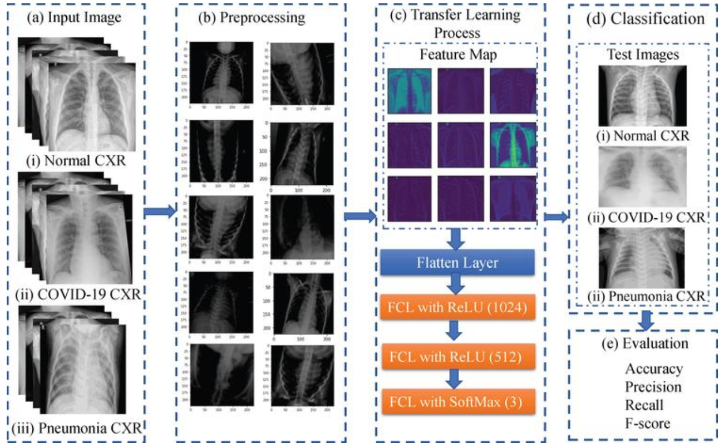
Using Convolutional Neural Networks

Slide 3
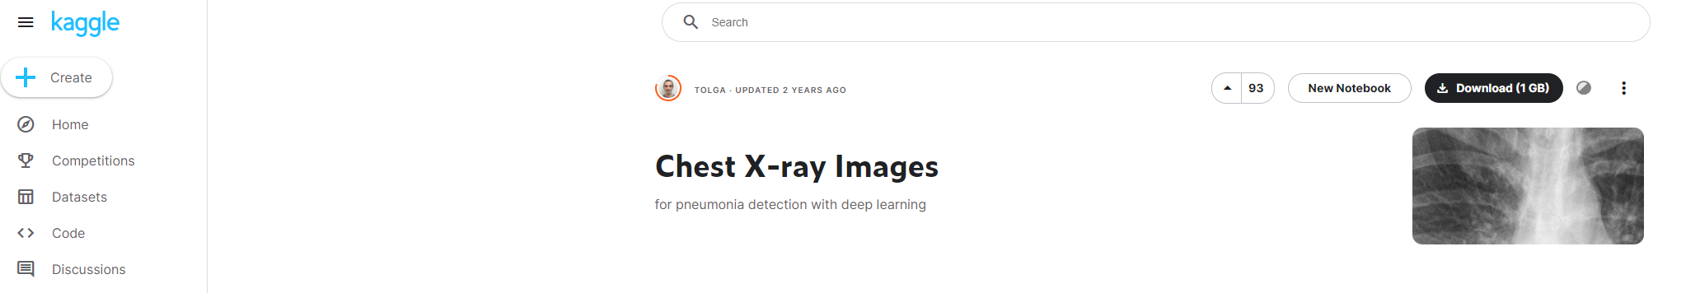
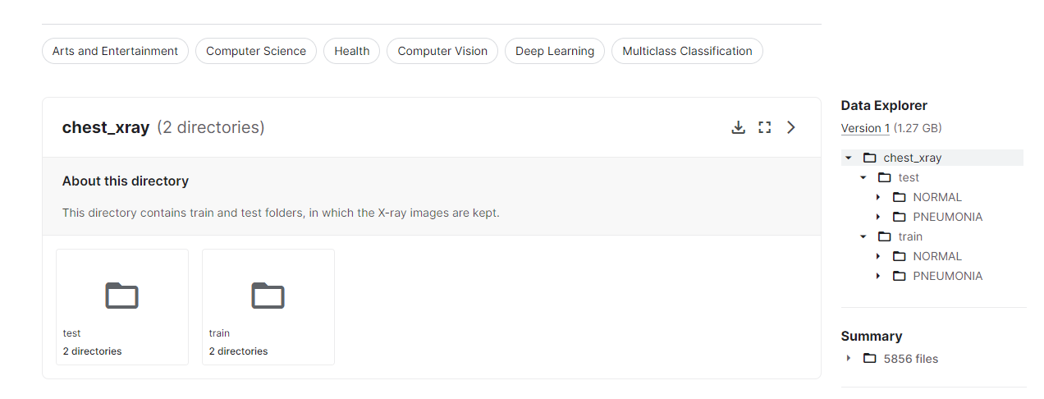
Images are taken from Kaggle

Slide 4
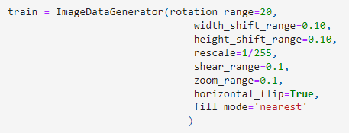
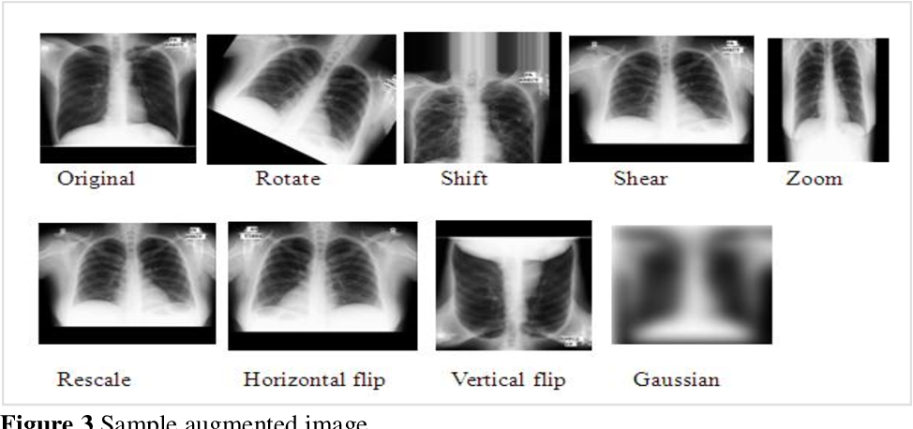
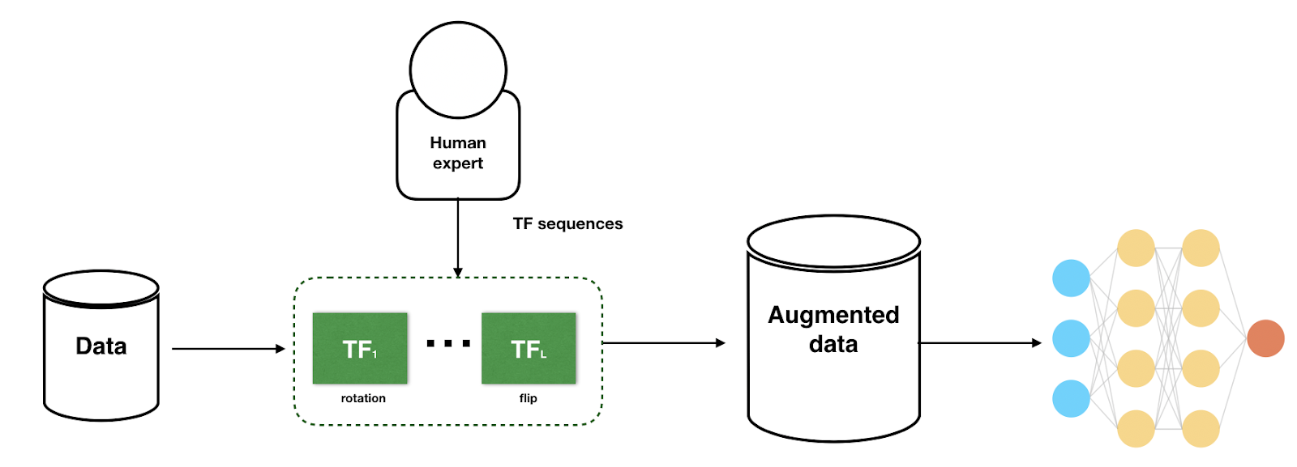
Data augmentation

Slide 5
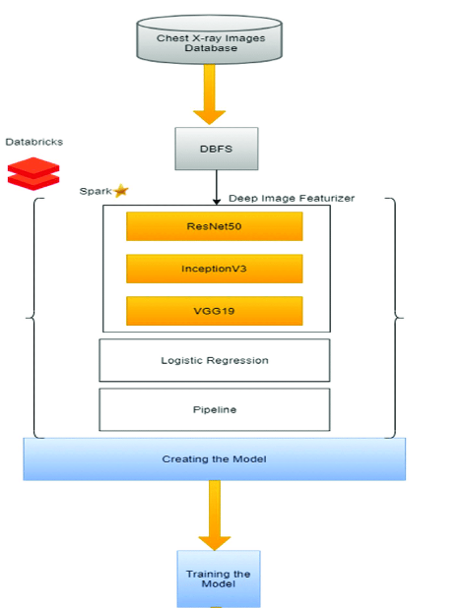
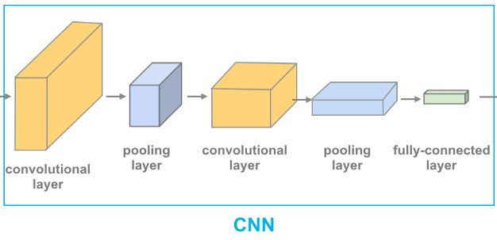
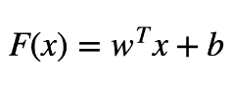
Give the weights of cnn to Linear regression .
-Ready weights.
-All parameters.
Just transfered
CNN
MaxPooling.

Slide 6
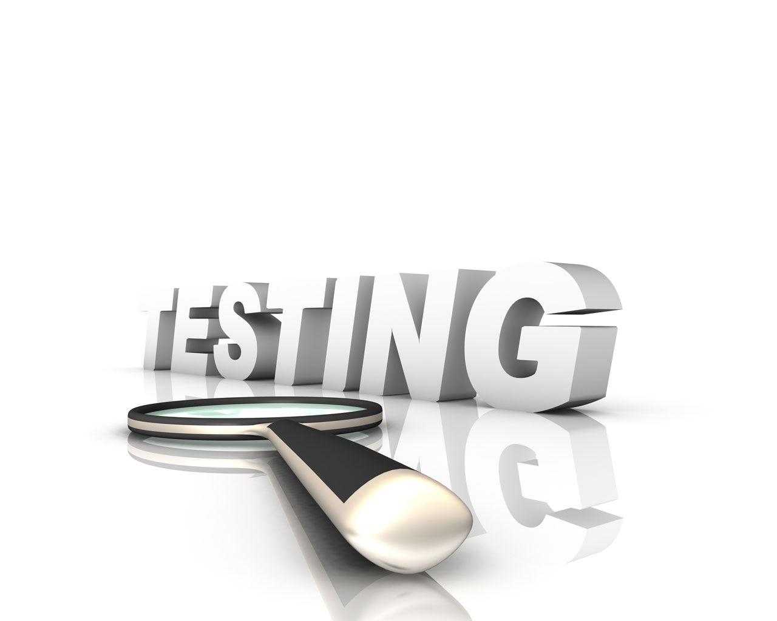
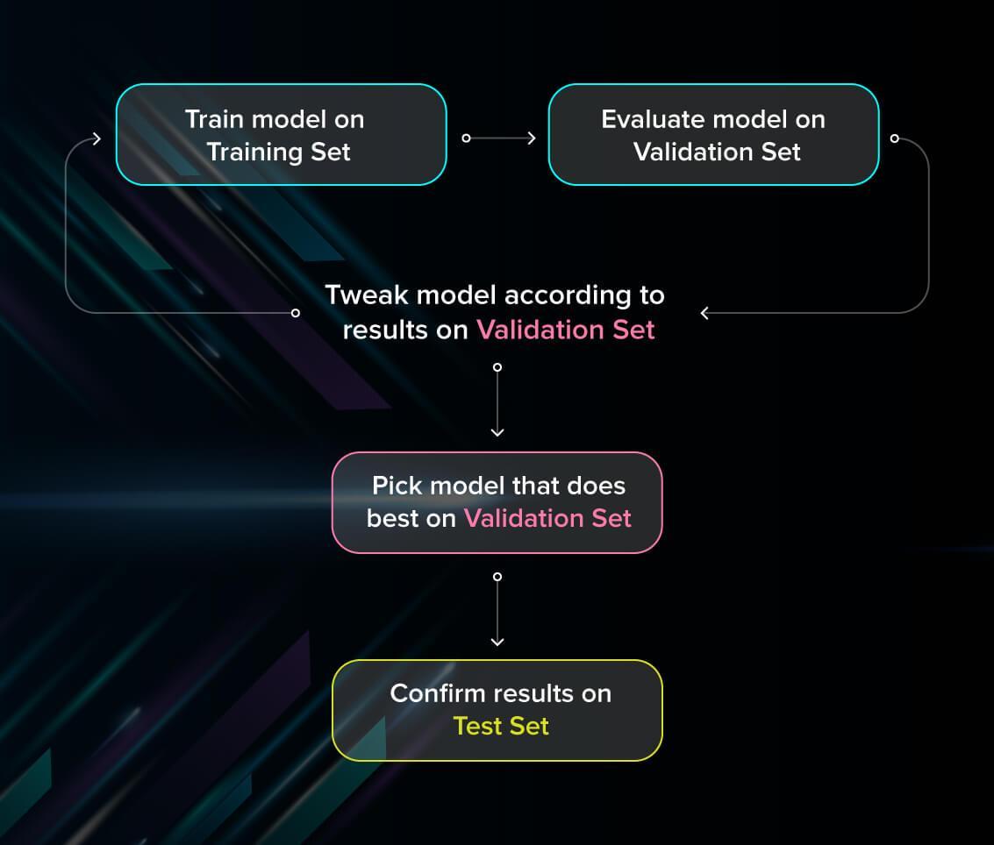
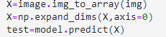
TESTING
-We do some preprocessingof the image. We will convert it to correct size that model accepts.
-Give the image with “model.predict” method.
-We get the images with the labels that we used in out data preprocessing for training.

Slide 7
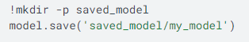

-Once we finish train We do not have to forget to save the model. -Because training takes lots of time, so we save the best epoch result.
Anyo one can take the model and use, it is saved with its weights.

Slide 8




What I will be using...

